Slide 1
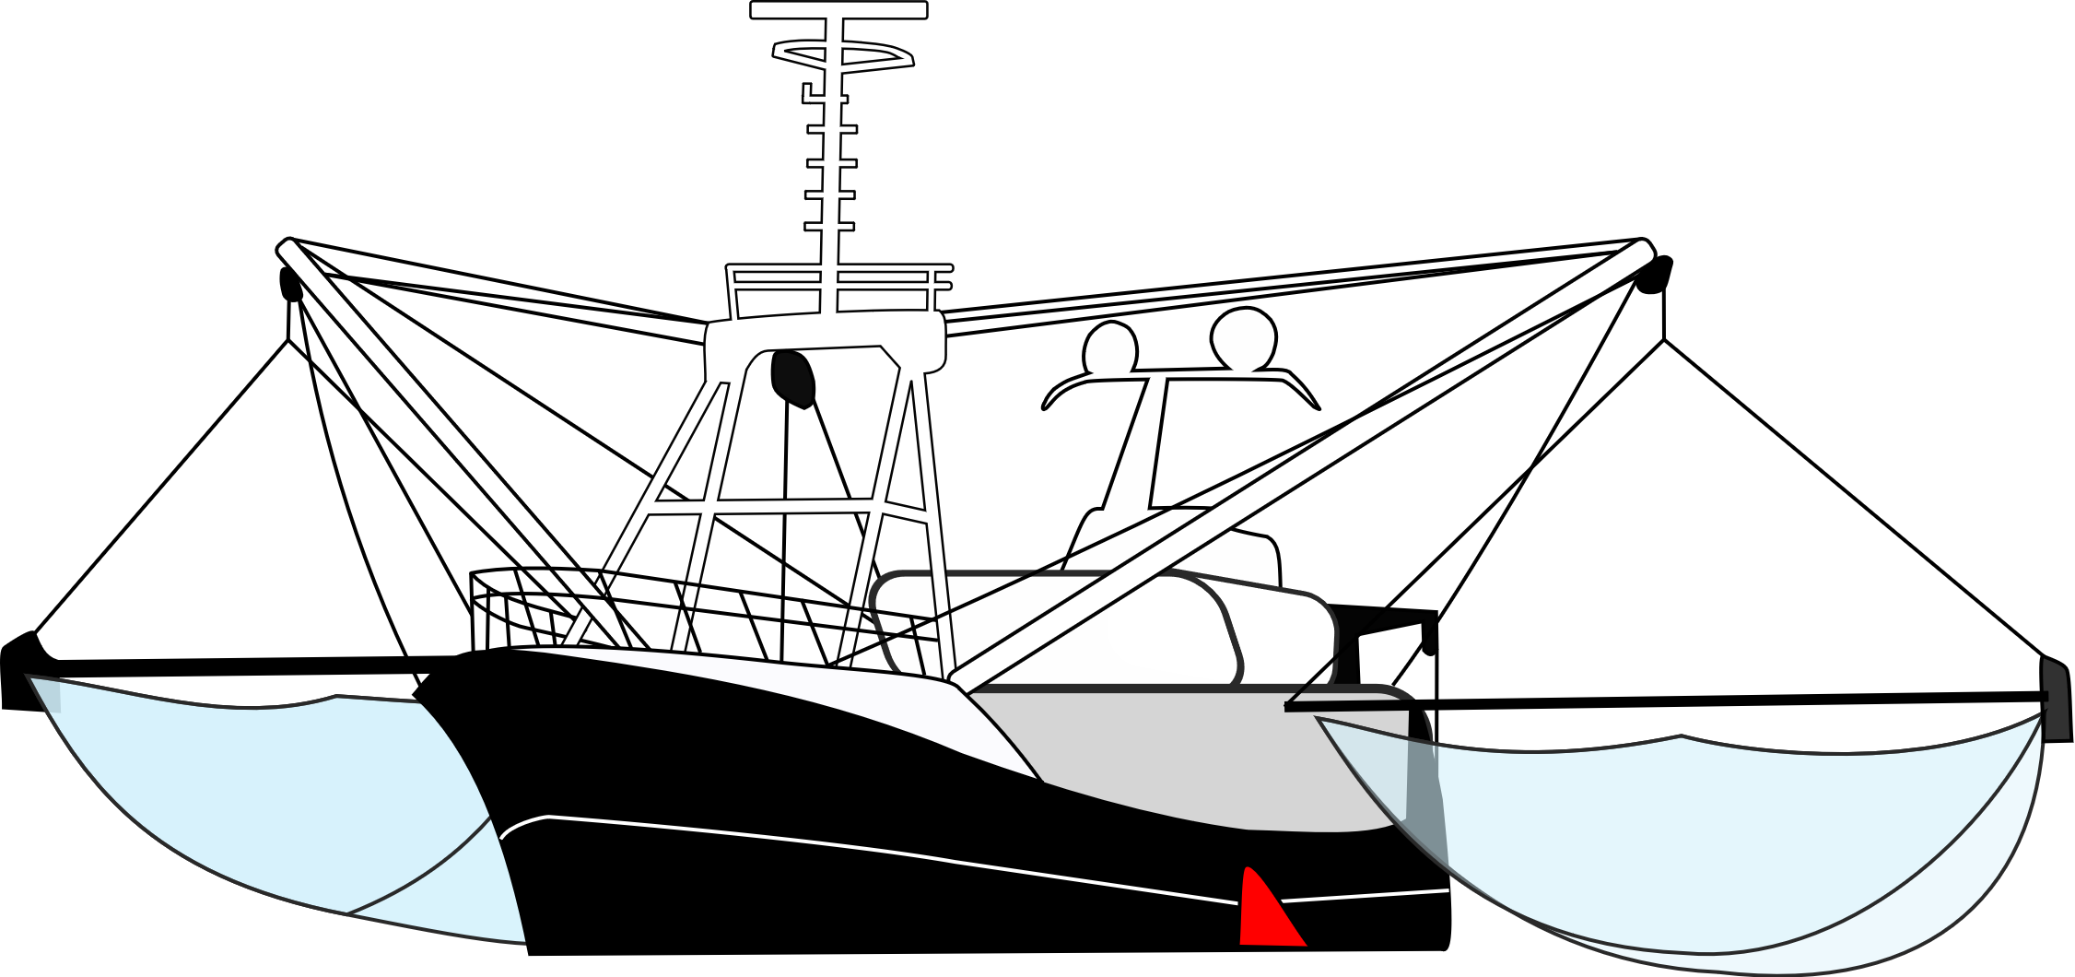

X
X
2020 Simulation
2020 Simulation
2020 Simulation
50 years
Biomass Decrease
1 year
Biomass Increase
1 year
Biomass Increase
2020
2020
2021
X
X
2020 Simulation
2020 Simulation
Focal Guild Biomass ≥ MSC Threshold
Recovery Time = 3 years
1 year
Biomass Increase
1 year
Biomass Increase
2022
2023

Slide 2
Baseline
Scenario
For t = start year
For t = start year
NM_{t}
Fishing
NM_{t}
Fishing
Burn-in
× 50 years
× 50 years
For t = start year
For t = start year
NM_{t}
Fishing
NM_{t}
Fishing
Transient
For t = t+1
NM_{t}
Fishing
NM_{t}
Fishing
While
t ≤ 2099

